Slide 1
FORTUNATE CHILDREN OF PAKISTAN: ROLE OF BIRTH ORDER ON EDUCATIONAL ATTAINMENT
Dr. Syed Hassan Raza
School of Economics, Quaid-i-Azam University Islamabad

Slide 2
INTRODUCTION
Education and Labor Market
Education affects economic conditions of people by increasing their earnings in Labor market (Quinn and Rubb, 2006).
Higher Education attainment Higher will be the possibilities to get better employment, Higher wages and higher wage growth (Borghans et al.2019).
Higher educated people are more productive which makes them less vulnerable to Unemployment (Nunez and Livanos, 2009).
Nation with more educated people will be rich with better Human Capital which in turn helps Countries to grow (S.Adedeji and A.Campbell, 2005).
Education policy making depends upon understanding the relationship between labor market outcomes and education, how these factors affect the individual and national prosperity.
Education attainment depends upon the education policies of the country, mode of the labor market, preferences of the people in a country and various other national factors.
Education attainment of people does also depends upon household characteristics such as socio-economic conditions of a household, demographic belongings of a household, cultural preferences etc

Slide 3
INTRODUCTION
Education attainment and Factors affecting education attainment
Education policy of a nation
Household characteristics: Socio-economic conditions of a household (i.e. Household income, Household wealth, family type etc.), Demography and cultural preferences etc.
Idiosyncratic characteristics: Gender, number of siblings, Intelligence and more prominently Birth order

Slide 4
INTRODUCTION
Why does birth order affects education attainment?
Resource Dilution hypothesis (Black ,1981)
Educational success of children depends upon parental resources
Limited parental resources (i.e. time, energy and financial resources)
Parental resources available to every child reduces with additional child
Confluence Hypothesis(Zajonc and Markus, 1975)
Educational success and intelligence of a child depends upon cognitive stimulation available to every child.
First born child enjoys rich cognitive stimulation i.e. he has to interact directly with two cognitively mature parents.
Latter born child has to interact with other infant siblings as well alongside parents.

Slide 5
OBJECTIVES OF THE STUDY
To explore the determinants of education attainment in Pakistan particularly role of birth order.
To study birth order effects nation-wide for sons and daughters followed by cohort analysis with respect to sons and daughters.
To capture Birth order effects with geographical dimension over rural and urban setting
To draw policy recommendations to improve the education attainment in Pakistan

Slide 6
CONTRIBUTION OF THE STUDY
This study helps understand factors behind education attainment in Pakistan.
This study helps policymakers to devise educational policies for Pakistan.
This study aims bridge the gap in literature by providing empirical analysis on education attainment particularly the role of birth order in Pakistan

Slide 7
LITERATURE REVIEW
Author (s) | Title | Country | Empirical methodology | Findings
Enkelejda Havari and Marco Savegnago (2020) | The intergenerational effects of birth order on education | European countries included in the Survey of Health, Ageing and Retirement in Europe (SHARE) | OLS technique | First born parents and children born to first born parents are better educated as compared to latter born parents. Mother’s education and birth order has stronger effect on children’s education than father’s Girls education is more affected by parents and their own birth order
Bagger et al (2013) | Education, birth order and family size | Denmark | OLS technique | Family size is negatively associated with education attainment of child Birth order effects, whether included linearly or nonlinearly, are negative, large and highly significant.
Moshoeshoe (2016) | Birth Order Effects on Educational Attainment and Child Labour: Evidence from Lesotho. | Lesotho | OLS technique | Negative effects of birth order on education and child labor Birth order effects are more pronounced in large families, and families with first-born girls, which suggests presence of girl’s education bias

Slide 8
LITERATURE REVIEW
Author (s) | Title | Country | Empirical methodology | Findings
Jaqueline Oliveira (2018) | Birth order and the gender gap in educational attainment | China | OLS and Family fixed effect technique | Daughter’s schooling decreases with the number of younger siblings Son’s schooling increases with the number of younger siblings
Haan (2009) | Birth order, family size and educational attainment | Netherland | OLS and Instrumental variable approach | No significant effect of family size on educational attainment of the oldest child is found. Birth order has a significant negative effect Birth order effects are not affected by the average age gap between children
Esposito et al (2020) | The importance of being earliest: birth order and educational outcomes along the socioeconomic ladder in Mexico | Mexico | Logit models with and without fixed effects. | Birth order effects on education ae negative Finally, we find that firstborns’ advantage is amplified when they are male, and in particular when other siblings are female

Slide 9
RESEARCH DESIGN
Empirical Model
Resource dilution Model:
Resource Dilution explains the association between sibling size and education attainment
Since parental resources are finite (e.g. time, energy and financial resources) and the subsequent number of siblings decreases the share of parental resources available to each child thus shrinking the chances of intellectual development and higher education attainment of subsequent child.
Variable Description
We have employed HIES 2018-19 data which is nationally representative data set
The education attained ranges from Montessori up to PhD. “0” refers to Montessori while “17” refers to M.s, M.Phil. and PhD cumulatively.
Birth order shows the ordering of children, where “1” shows first born and “0” shows latter born.
We have used real monthly income as a flow variable while the total wealth, comprising agriculture and non-agriculture wealth as stock variable.
The variable “bad accommodation” shows absence of clean water, internet and waste management system.
“Worried for food” shows the household members were “worried about not having enough food to eat because of lack of money or other resources”.

Slide 10
RESEARCH DESIGN
Sample Selection
Individuals above the age of education attainment i.e. above 22 years old.
Total observation of sons: 8729
Total observation of Daughters: 2679
Further, we exclude those individuals who are currently studying. After restricting our data we ended up with 8,729 sons and 2,679 daughters who fall the above criteria. Table 1 shows descriptive statistics for sons and daughters.

Slide 11
STATISTICAL ANALYSIS
Fortunate children of Pakistan: Role of birth order on education attainment
Table 1 Descriptive statistics sons and daughters This table reports descriptive statistics(mean and s.d.) for sons(top panel) and daughters (bottom panel). Our main sample includes children aged above 22 years. | Variable | Mean | s.d
 | Male(sons)
 | Years of education | 7.19 | 5.06
 | Age | 28.45 | 5.96
 | First born | .64 | .47
 | Family size | 3.97 | 2.02
 | Household income | 25026.92 | 28529.14
 | Household wealth | 2818.37 | 20463.3
 | Bad accommodation | .82 | .38
 | Worried for food | .11 | .32
 | Observations | 8729
 | Female(daughters)
 | Years of education | 7.02 | 5.93
 | Age | 26.86 | 5.57
 | First born | .80 | .39
 | Family size | 3.46 | 2.71
 | Household income | 3977.815 | 11385.57
 | Household wealth | 4192.65 | 28926.26
 | Bad accommodation | .79 | .40
 | Worried for food | .12 | .32
 | Observations | 2679

Slide 12
STYLIZED FACTS

Slide 13
STYLIZED FACTS

Slide 14
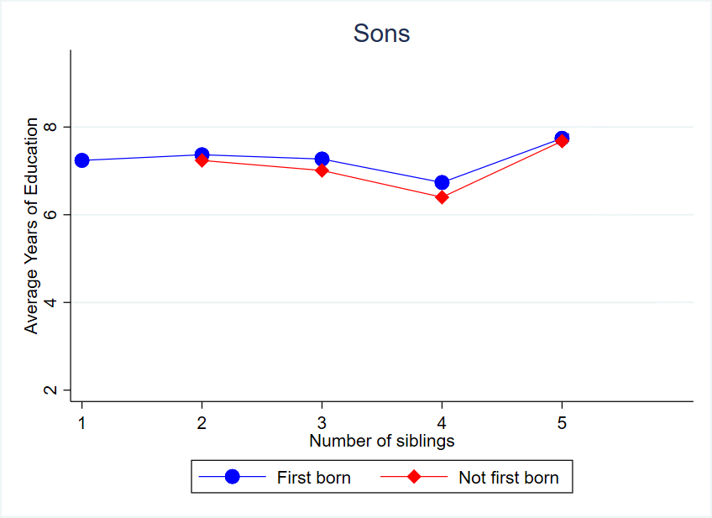
STYLIZED FACTS

Slide 15
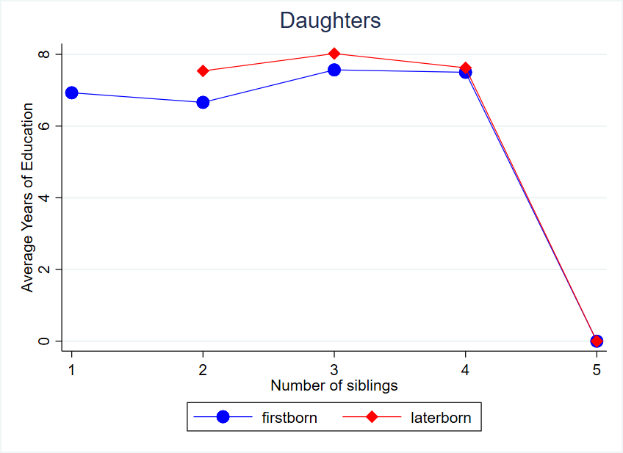
STYLIZED FACTS

Slide 16
REGRESSION RESULTS FOR SONS
The effect of male(son) birth order on own education attainment
Male years of schooling
 | Nation-wide | First cohort (1952-75) | 2nd cohort (1976-97) | Rural | Urban
First born | 0.261** | -1.416 | 0.294** | 0.078 | 0.469***
 | (0.125) | (0.993) | (0.129) | (0.173) | (0.186)
Family size | -0.621*** | -0.480 | -0.066*** | -0.646*** | -0.575***
 | (0.064) | (0.294) | (0.066) | (0.086) | (0.096)
Household income | 0.936*** | 1.859*** | 0.917*** | 1.096*** | 0.625***
 | (0.052) | (0.269) | (0.053) | (0.070) | (0.078)
Household wealth | 0.381*** | 0.539** | 0.380*** | 0.362*** | 0.540***
 | (0.052) | (0.270) | (0.053) | (0.063) | (0.096)
Bad accommodation | -3.152*** | -3.085*** | -3.147*** | -2.728*** | -2.833***
 | (0.134) | (0.709) | (0.136) | (0.491) | (0.157)
Worried for food | -2.27*** | -2.557** | -2.243*** | -2.282*** | -1.970***
 | (0.158) | (0.819) | (0.161) | (0.189) | (0.293)
Constant | 8.264*** | 6.015*** | 8.312*** | 7.456*** | 8.811***
 | (0.251) | (1.590) | (0.255) | (0.569) | (0.355)
N | 8661 | 268 | 8393 | 5059 | 3602
R2-adj | 0.15 | 0.30 | 0.14 | 0.09 | 0.14

Slide 17
REGRESSION RESULTS FOR DAUGHTERS
he effect of female(daughter) birth order on own education attainment
Female years of schooling
 | Nation-wide | First cohort (1952-75) | 2nd cohort (1976-97) | Rural | Urban
First born | -0.769** | -0.148 | -0.789** | -0.566 | -0.991**
 | (0.332) | (2.126) | (0.338) | (0.448) | (0.487)
Family size | -0.540** | 0.618 | -0.592** | -0.389 | -0.682***
 | (0.184) | (0.819) | (0.188) | (0.241) | (0.281)
Household income | 1.143*** | 1.033** | 1.171*** | 1.127*** | 1.056***
 | (0.080) | (0.450) | (0.081) | (0.118) | (0.110)
Household wealth | 0.337*** | 1.878*** | 0.292** | 0.393** | 0.359**
 | (0.102) | (0.562) | (0.103) | (0.127) | (0.168)
Bad accommodation | -4.424*** | -10.054*** | -4.288*** | -3.458*** | -3.341***
 | (0.256) | (1.816) | (0.259) | (0.949) | (0.309)
Worried for food | -3.317*** | -3.062 | -3.312*** | -3.173*** | -3.411***
 | (0.312) | (1.850) | 0.315) | (0.381) | (0.535)
Constant | 9.889*** | 8.572*** | 9.937*** | 7.942*** | 10.541***
 | (0.573) | (3.176) | (0.583) | (1.187) | (0.801)
N | 2656 | 66 | 2590 | 1500 | 1156
R2-adj | 0.22 | 0.41 | 0.22 | 0.11 | 0.20

Slide 18
RESULTS AND DISCUSSION
Main Results
The birth order effects are negative and significant for first born girls while it is positive and statistically significant for first born boys.
Birth order does not play significant role in rural setting while in urban setting first born boys have positive and significant effects but for girls it shows negative relationship.
Cohort analysis shows that birth order plays significant role after 1976, it’s role on education attainment prior to 1976 is insignificant.

Slide 19
DISCUSSION
Why are first born girls inversely related to education attainment?
Women are perceived to be unproductive
Politically disempower
Patriarchal norms
The labor market in Pakistan provides unequal opportunities to female i.e. labor market in Pakistan offer low wage jobs to women; deny facilities which women biology demands thus disincentivising parents to invest in girls education (Sharif and Afzal 2010).

Slide 20
ROBUSTNESS CHECK
The effects of birth order on education of female and male, separate regression by family size
 | Family size=3 | Family size>3
Female
First born | -0.654** | -0.214*
 | (0.340) | (0.083)
N | 1583 | 1096
R2_adj | 0.21 | 0.39
Male
First born | 0.681*** | 0.295**
 | (0.150) | (0.130)
N | 6412 | 2237
R2_adj | 0.159 | 0.119

Slide 21
ROBUSTNESS CHECK
Effects of birth order for those households who are having more than one child
Female | Family size=3 | Family size>3
First born | -0.821** | -0.318*
 | (0.374) | (0.060)
N | 694 | 240
R2_adj | 0.30 | 0.40
Male
First born | 0.113** | 0.322**
 | (0.050) | (0.014)
N | 2940 | 2237
R2_adj | 0.17 | 0.13

Slide 22
CONCLUSION
Why is being first born boy increases the chances of education attainment while being first born girl decreases the chances of education attainment?
Cultural preference to boys
Economic advantages associated with boys
First born boys in urban areas is advantageous than being born in rural setting. Why?
Urban area provide better opportunities to education attainment

Slide 23
POLICY RECOMMENDATIONS
Parents must be incentivize to invest in girls education which can be achieved through women friendly policies.
Proper legislation needs to be enacted which must ensure equal wages and benefits to women.
Social safety net should be diverted to Urban areas so that the education attainment of people increase.

Slide 24
THANK YOU

